Slide 1
RuMedSpellchecker: correcting spelling errors for natural Russian language in electronic health records using machine learning techniques
Dmitry Pogrebnoy, Anastasia Funkner, Sergey Kovalchuck
ITMO University
International Conference on Computational Science
3-5 July, 2023

Slide 2
Electronic health records
Many medical models based on patients' medical records
Quality of models depends mainly on the quality of source texts
Patient records is a simple text
Unstructured
Hand-typed
Plain
Such texts may contain a lot of spelling errors
2/24

Slide 3
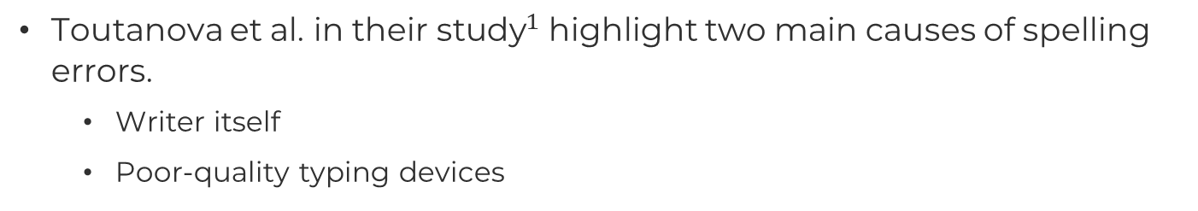
Spelling errors in EHRs
Toutanova et al. in ${\text{their} \text{study}}^{1}$ highlight two main causes of spelling errors.
Writer itself
Poor-quality typing devices
Spelling errors greatly reduce the quality of the final models
Fixing such errors will improve the quality of the medical models
$^{1}$Toutanova, K., Moore, R.C.: Pronunciation modeling for improved spelling correction. In: Proceedings of the 40th Annual Meeting on Association for Computational Linguistics. p. 144–151. ACL ’02, Association for Computational Linguistics, USA (2002).
3/24

Slide 4

Goal
Goal: Design a method and implement an automatic spelling correction tool for medical texts in Russian.
Tool requirements:
Accepts raw plain text
Returns the text with the minimal spelling errors
Can utilize the GPU to accelerate processing
Comparable in performance to existing tools
Outperforms existing open source tools
Quality of spelling errors correction of Russian medical texts
4/24

Slide 5
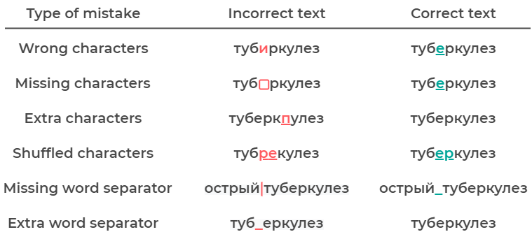
Spelling errors
$$1$$
$$2$$
$^{1}$tuberculosis
$^{2}$acute tuberculosis
5/24

Slide 6
Existing tools
There are several open source tools for Russian texts
Aspell
Hunspell
Enchant
LanguageTool
Symspell
Jumspell
Not one is intended for medical texts
Not one uses advanced language models
6/24

Slide 7
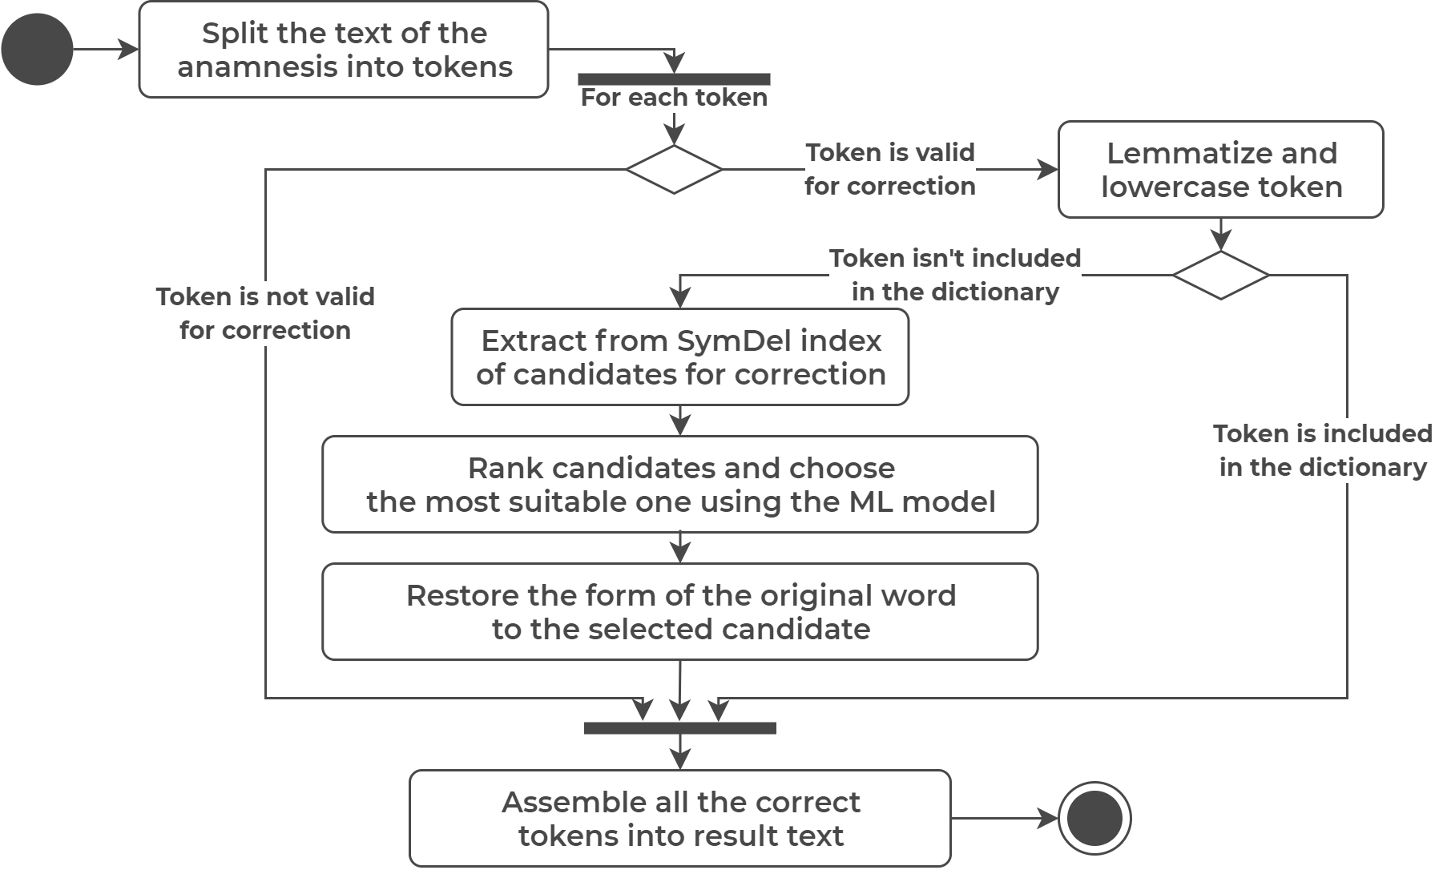
Spelling correction process
7/24

Slide 8
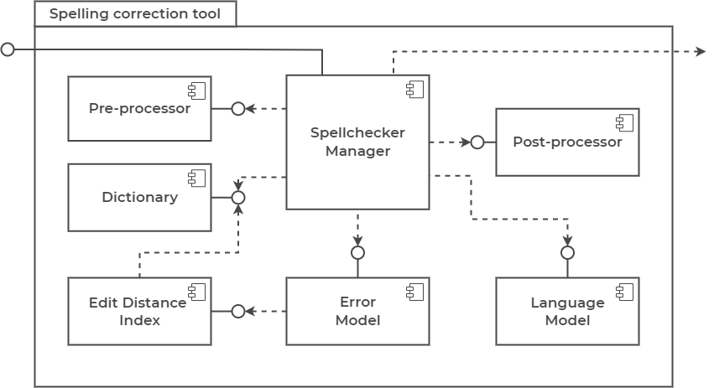
Tool architecture
8/24

Slide 9
Source anamneses datasets
Public datasets
RuMedNLI – 14716 records
RuMedPrimeData – 15249 records
Private datasets
Almazov National Medical Research Center – 2355 records
Research Institute of the Russian Academy of Sciences – 161 records
9/24

Slide 10
Assembled anamneses dataset
All datasets were pre-processed and assembled into final one
Tokenization and lemmatization
Stop words filtering
Assembled anamneses dataset
Contains 30,737 medical records in Russian
Takes about 10.25 Mb
10/24

Slide 11
Fine-tune BERT models
sberbank-ai/ruRoberta-large → MedRuRobertaLarge
Size – 1.4 Gb
distilbert-base-multilang-cased → MedDistilBertBaseRuCased
Converted from multilang to Russian model
Size - 217 Mb
cointegrated/rubert-tiny2 → MedRuBertTiny2
Size – 117 Mb
All models are published on the Hugging Face repository
11/24

Slide 12
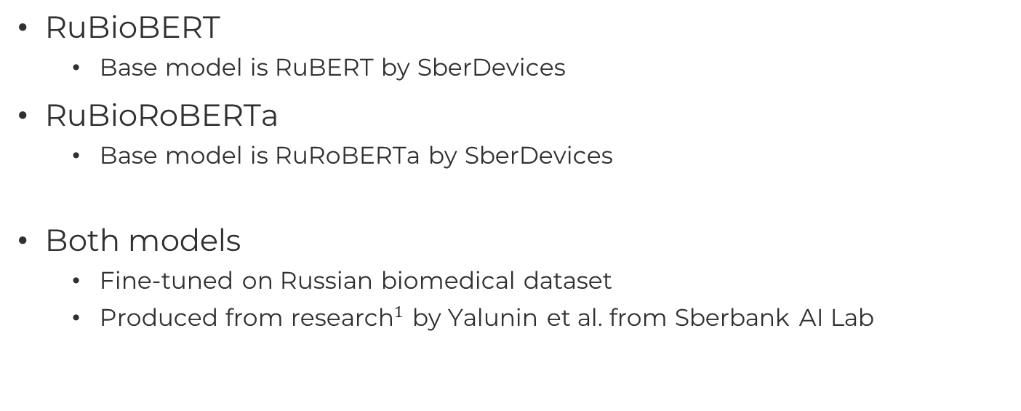
Adopted BERT models
RuBioBERT
Base model is RuBERT by SberDevices
RuBioRoBERTa
Base model is RuRoBERTa by SberDevices
Both models
Fine-tuned on Russian biomedical dataset
Produced from ${\text{research}}^{1}$ by Yalunin et al. from Sberbank AI Lab
$^{1}$Yalunin, A., Nesterov, A., Umerenkov, D.: Rubioroberta: a pre-trained biomedical language model for russian language biomedical text mining (2022)
12/24

Slide 13
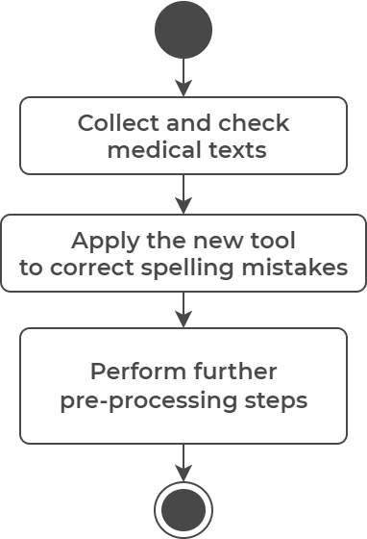
Method of tool use
Only for correction of medical texts in Russian
Preferably use for medical anamneses
Use in the preprocessing pipelines
Use before any other preprocessing steps
Make sure everything is okay afterwards
13/24

Slide 14
Example of correction
Tool | Corrected Result
Original | тревожное расстройство (золофт) и атопичекий дерматит
Aspell-python | тревожное расстройство золота и тапочкой дерматит
PyHunspell | тревожное расстройство золото аи топический дерматит
PyEnchant | тревожное расстройство золото аи атипический дерматит
LanguageTool-python | тревожное расстройство (золото) и утопический дерматит
PySpellChecker | тревожно расстройство (золофт) и атопичекий дерматит
SymspellPy | тревожное расстройство (золофт) и утопический гематит
Jumspell | тревожное расстройство (золофт) и атопичекий дерматит
Tool (MedDistilBERT) | тревожное расстройство ( золофт ) и атопический дерматит
$$1$$
$^{1}$anxiety disorder (zoloft) and atopic dermatitis
14/24

Slide 15
Word tests internals
Single test - error and lexical precision
2700 test samples
Context test - error and lexical precision
2700 test samples
10 words in each sample
One of ten words is incorrect, other words are correct
Same incorrect words as in single test
Test on real anamnesis
100 real anamnesis from Almazov Center dataset
Count the correct and unnecessary corrections
15/24

Slide 16
Metrics
Error precision – the ratio of the number of correctly corrected words to the total number of incorrect words
Lexical precision – the ratio of the number of unchanged modified words to the total number of correct words
Average precision – the average of error precision and lexical precision
Performance – the number of words processed by the tool per second
Correct fixes - the number of correctly fixed errors
Unnecessary fixes - the number of correct words corrected
Fixes ratio - the ratio of the correct fixes metric to the unnecessary fixes
16/24

Slide 17
Single word test
Tool | Error precision | Lexical precision | Average precision | Average words per second
Aspell-python | 0.86 | 0.859 | 0.859 | 283.7
PyHunspell | 0.812 | 0.539 | 0.675 | 9.4
PyEnchant | 0.829 | 0.541 | 0.685 | 20
LanguageTool-python | 0.762 | 0.904 | 0.833 | 25.1
PySpellChecker | 0.354 | 0.86 | 0.607 | 3.4
SymspellPy | 0.399 | 0.813 | 0.606 | 9702.8
Jumspell | 0.267 | 0.947 | 0.607 | 2552.1
Tool (CPU, MedDistilBERT) | 0.701 | 0.991 | 0.846 | 12.7
Tool (GPU, MedDistilBERT) |  |  |  | 39.7
17/24

Slide 18
Context word test
Tool | Error precision | Lexical precision | Average precision | Average words per second
Aspell-python | 0.739 | 0.93 | 0.835 | 357.3
PyHunspell | 0.706 | 0.719 | 0.713 | 11.8
PyEnchant | 0.721 | 0.719 | 0.72 | 24.3
LanguageTool-python | 0.727 | 0.942 | 0.835 | 43.6
PySpellChecker | 0.304 | 0.868 | 0.586 | 6.7
SymspellPy | 0.37 | 0.913 | 0.642 | 26060.2
Jumspell | 0.307 | 0.969 | 0.638 | 4322.3
Tool (CPU, MedDistilBERT) | 0.765 | 0.99 | 0.878 | 45.5
Tool (GPU, MedDistilBERT) |  |  |  | 153.8
18/24

Slide 19
Test on real anamnesis
Tool | Correct fixes | Unnecessary fixes | Fixes ratio
Aspell-python | 20 | 171 | 0.105
PyHunspell | − | − | −
PyEnchant | − | − | −
LanguageTool-python | 21 | 135 | 0.135
PySpellChecker | − | − | −
SymspellPy | − | − | −
Jumspell | − | − | −
Tool (MedRoBERTa) | 19 | 6 | 0.76
Tool (MedDistilBERT) | 18 | 9 | 0.667
Tool (MedBertTiny2) | 17 | 11 | 0.607
19/24

Slide 20
Tool performance
Tool is written in Python
Damerau-Levenstein distance is used to reduce candidates for ranking
SymDel index is used to speed up distance calculations
Performance-critical operations are delegated to high-performance libraries
Edit distance calculation – editdistpy package
Model inference – transformers and accelerate packages
Tool can use a suitable GPU to accelerate the model inference
20/24

Slide 21
Python package
Assembled the pip python package
Package contains
Source code
Dictionary with correct words
No models included
Models are loaded dynamically as needed
Published package name – medspellchecker
21/24

Slide 22
Conclusion
New method for correcting medical texts in Russian is presented
New tool implementing the proposed method is developed
Tests have shown that the new tool is outperforming existing tools
In the task of correcting spelling errors in Russian medical texts
New tool is open sourced and published as a pip package
Fine-tuned models are available on HuggingFaces
22/24

Slide 23
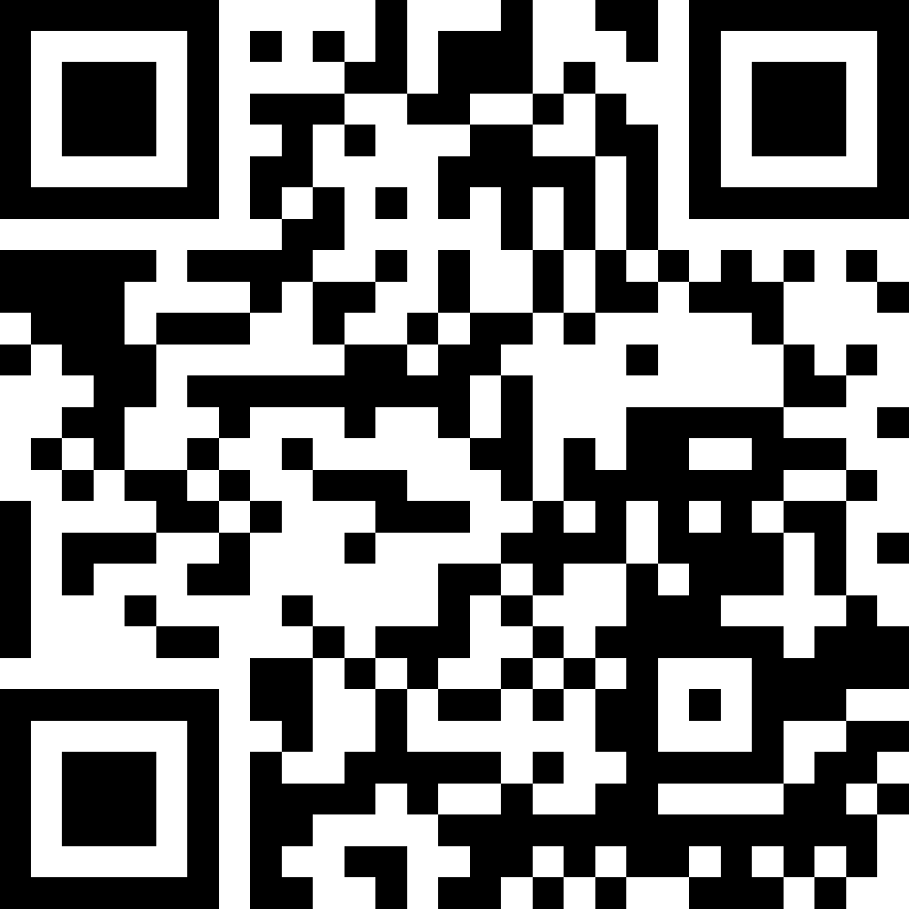
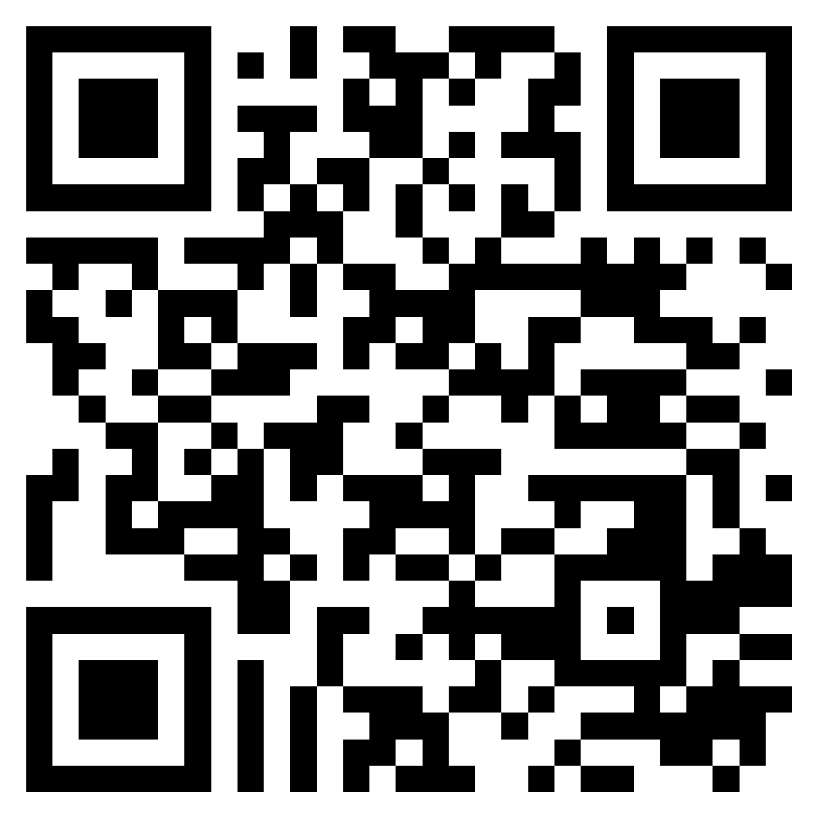
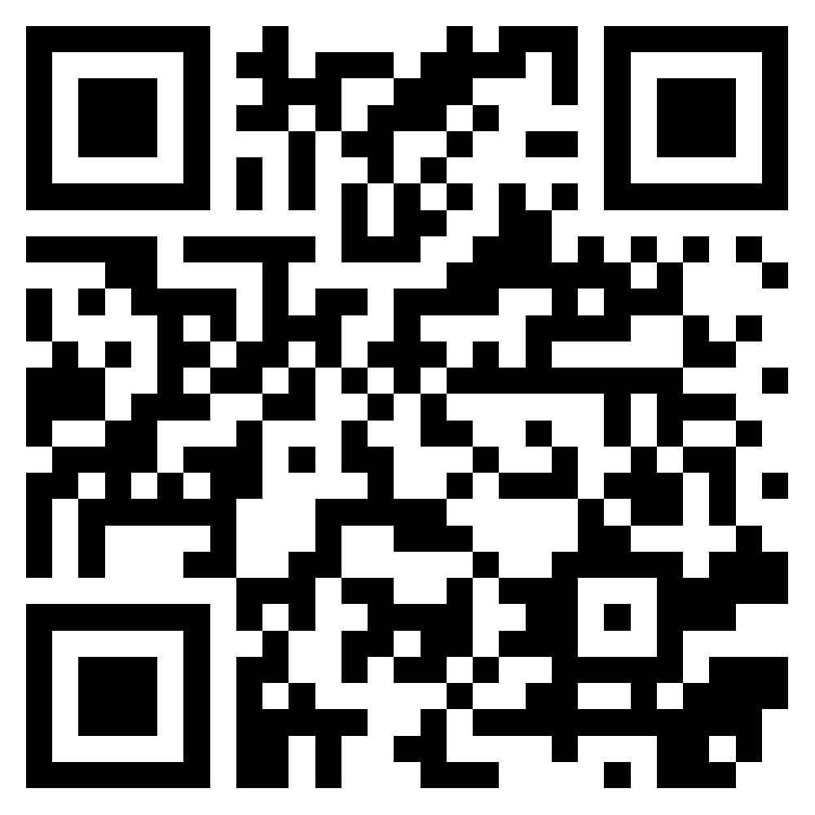
Links
GitHub project
github.com/DmitryPogrebnoy/MedSpellChecker
Fine-tuned models
huggingface.co/DmitryPogrebnoy
Pip package
pypi.org/project/medspellchecker
23/24

Slide 24

Thank you for attention!

